Slide 1

CO1 – AT2
Evolution of Cloud Computing Technology
COURSE CODE:CSA1514
COURSE NAME: CLOUD COMPUTING
BY
G.SAI SAHITH
192424179

Slide 2
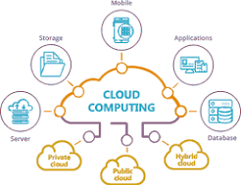
What is Cloud Computing?
Cloud Computing is the delivery of computing services such as servers, storage, databases, networking, and software over the Internet instead of using a personal computer.
Instead of storing files on your laptop, you save them in Google Drive and access them from anywhere.

Slide 3
Before Cloud Computing (1960–1990)
Birth of Cloud Computing (1990–2005)
Traditional Computing
Every company had its own computers.
Data was stored locally.
High maintenance cost.
Difficult to upgrade hardware.
Limited storage.
What Changed?
Internet became faster.
Companies started providing online services.
Virtualization technology became popular.
Shared computing resources reduced costs.
Example
A college stores all student records on one computer in the office.
Major Development
Web applications
Online storage
Data centers

Slide 4
Growth of Cloud Computing (2006–2015)
Popular Services
Online storage
Virtual Machines
Cloud Databases
Email services
Advantages
Lower cost
Easy access
High availability
Scalability
Major Cloud Platforms
Amazon Web Services (AWS)
Microsoft Azure
Google Cloud
Modern Cloud Computing (2016–Present)
New Technologies
Artificial Intelligence (AI)
Machine Learning (ML)
Internet of Things (IoT)
Edge Computing
Serverless Computing
Containers (Docker, Kubernetes)
Real-Life Examples
Netflix
Google Photos
ChatGPT
Microsoft 365

Slide 5
Future of Cloud Computing
Timeline
Future Technologies
AI-powered Cloud
Quantum Computing Integration
Green Cloud Computing
Edge Cloud
Autonomous Cloud Management
Expected Benefits
Faster processing
Better security
Lower power consumption
Smarter automation
Year | Evolution
1960s | Mainframe Computing
1990s | Internet Growth
2000 | Virtualization
2006 | AWS Launch
2008 | Google Cloud
2010 | Microsoft Azure
2015 | Hybrid Cloud
2020 | AI + Cloud
Future | Quantum + AI Cloud

Slide 6
Advantages of Modern Cloud
Disadvantages of Cloud Computing
Cost Saving
Easy Access
High Security
Automatic Updates
Backup & Recovery
Global Availability
Scalability
Internet Dependency
Security Risks
Privacy Issues
Downtime
Data Loss Risk
Conclusion
Cloud Computing has evolved from expensive local computers to intelligent cloud platforms that support AI, IoT, and modern applications. Today, cloud computing makes technology more accessible, scalable, and efficient, and it will continue to evolve with innovations like AI and quantum computing.

Slide 7
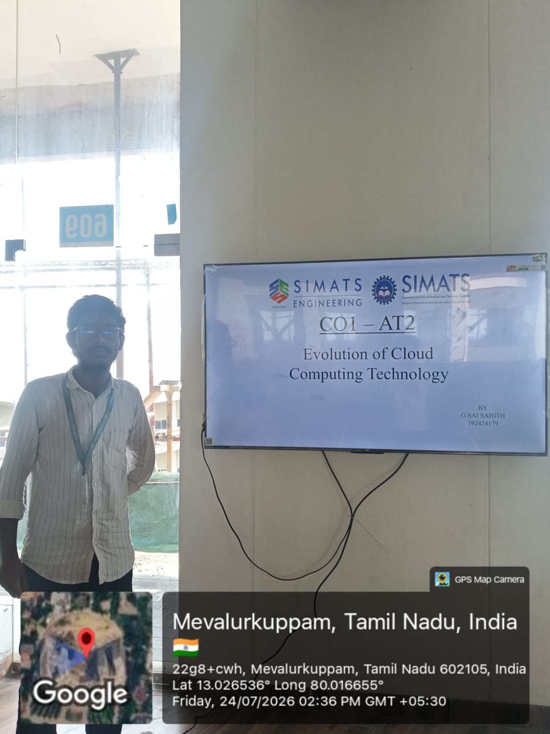
PRESENTATION PHOTO

Slide 8


